Slide 1
GP US Discount Sensitivity GBM model performance
January 2017

Slide 2
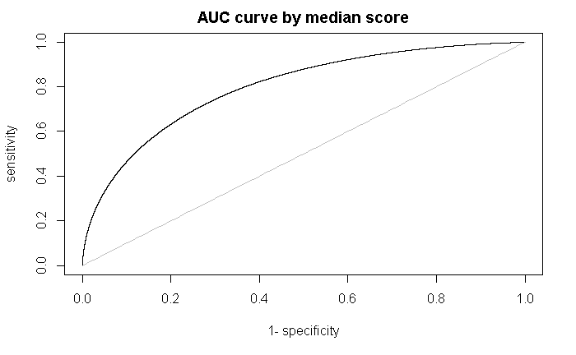
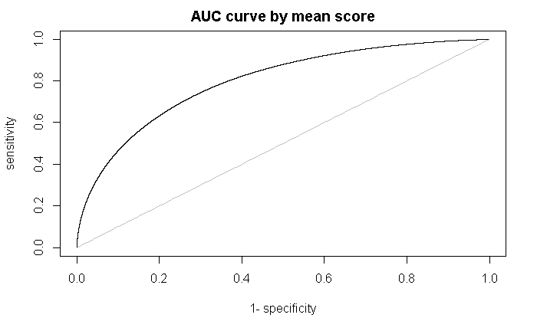
AUC Curve after ensemble
AUC by median ensemble 0.7977077
AUC by mean ensemble 0.7977377

Slide 3
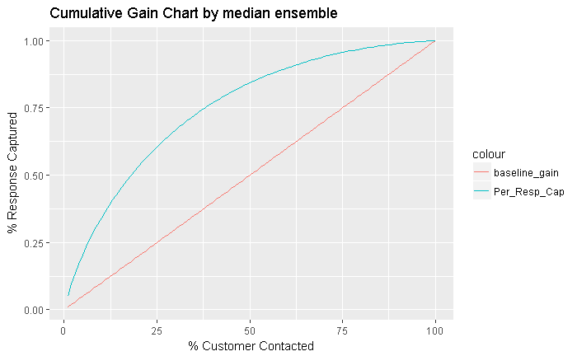
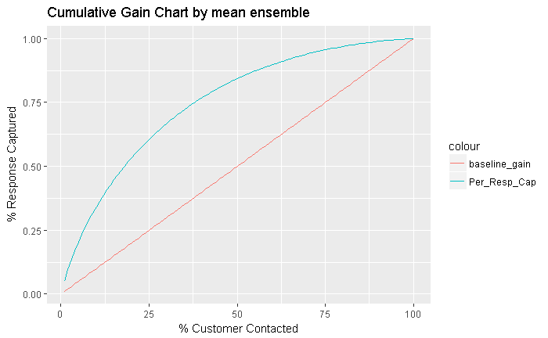
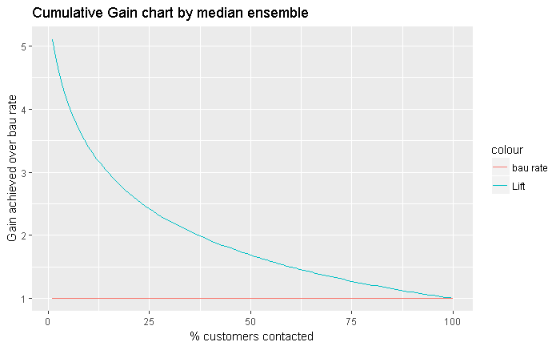
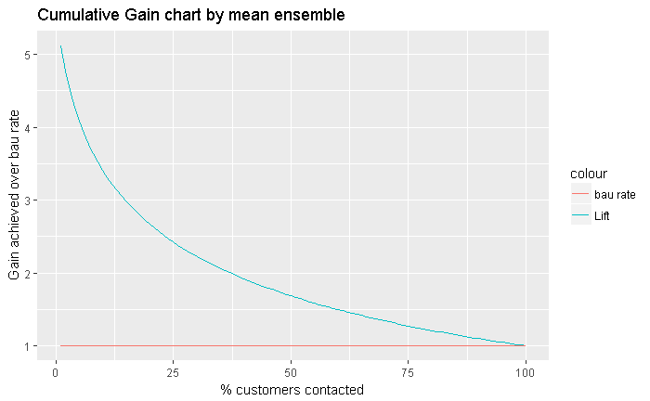
Cumulative Gain Chart and lift chart after ensemble
Overall BAU response rate 0.1634871

